Slide 1

OS Lab 8
Instructor
Aliza Saeed
aliza.saeed@nu.edu.pk

Slide 2
Inter process communication (IPC)
Inter process communication (IPC) is a mechanism which allows processes to communicate each other and synchronize their actions.
The communication between these processes can be seen as a method of co-operation between them.
Processes can communicate with each other using these two ways:
Shared Memory
Message passing

Slide 3
pipe() System call
a pipe is a connection between two processes, such that the standard output from one process becomes the standard input of the other process.
In UNIX Operating System, Pipes are useful for communication between related processes(inter-process communication).

Slide 4
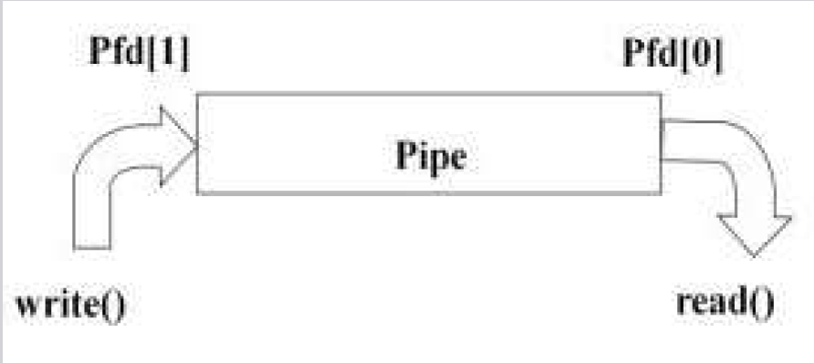

Slide 5
It is not very useful for a single process to use a pipe to talk to itself.
In typical use, a process creates a pipe just before it forks one or more child processes.
The pipe is then used for communication either between the parent or child processes, or between two sibling processes.

Slide 6
System Calls
Read ()
Write()
Close()
Pipe()
Dup(), Dup2()

Slide 7
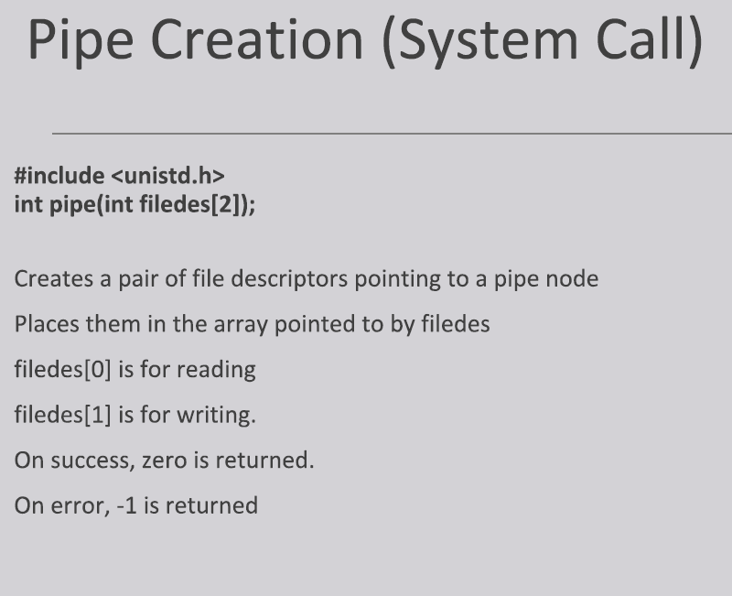

Slide 8
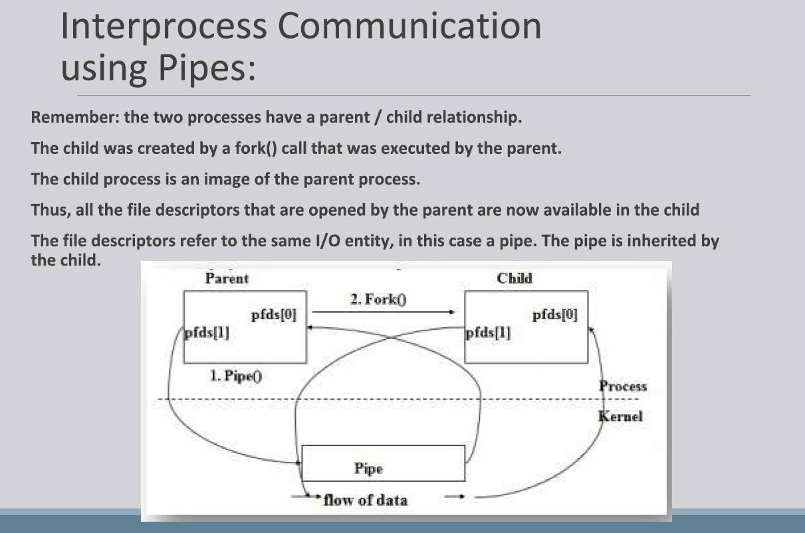

Slide 9
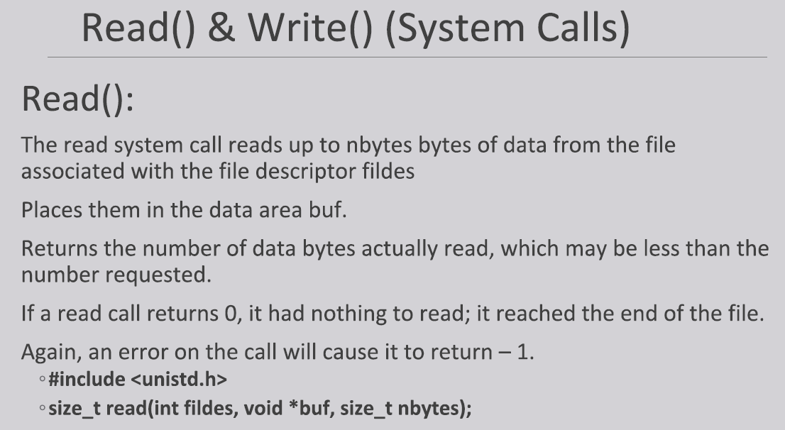

Slide 10
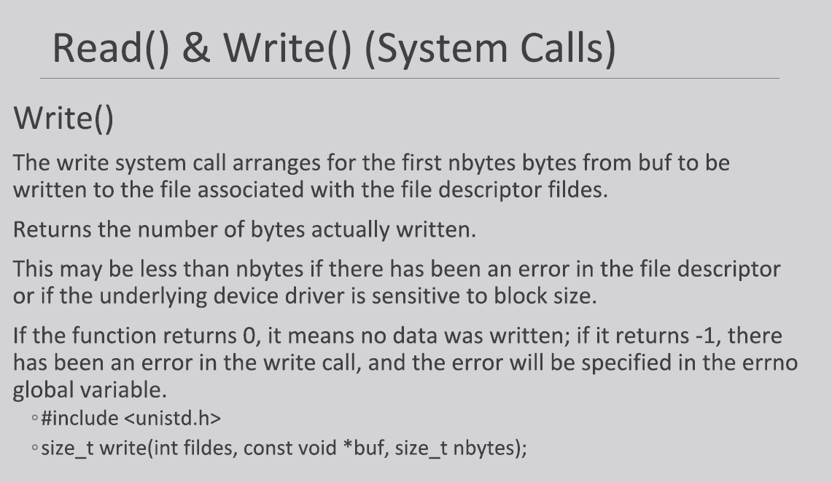

Slide 11


Slide 12
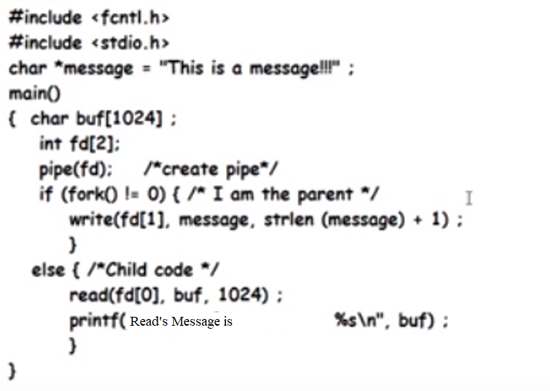
Example:- Pipe concept …!
Parent writes into pipe and child reads from pipe

Slide 13
Named pipe
In computing, a named pipe (also known as a FIFO) is one of the methods for inter-process communication.
It is an extension to the traditional pipe concept on Unix. A traditional pipe is “unnamed” and lasts only as long as the process.
A named pipe, however, can last as long as the system is up, beyond the life of the process. It can be deleted if no longer used.

Slide 14
Usually a named pipe appears as a file, and generally processes attach to it for inter-process communication. A FIFO file is a special kind of file on the local storage which allows two or more processes to communicate with each other by reading/writing to/from this file.
A FIFO special file is entered into the filesystem by calling mkfifo() in C. Once we have created a FIFO special file in this way, any process can open it for reading or writing, in the same way as an ordinary file. However, it has to be open at both ends simultaneously before you can proceed to do any input or output operations on it.

Slide 15
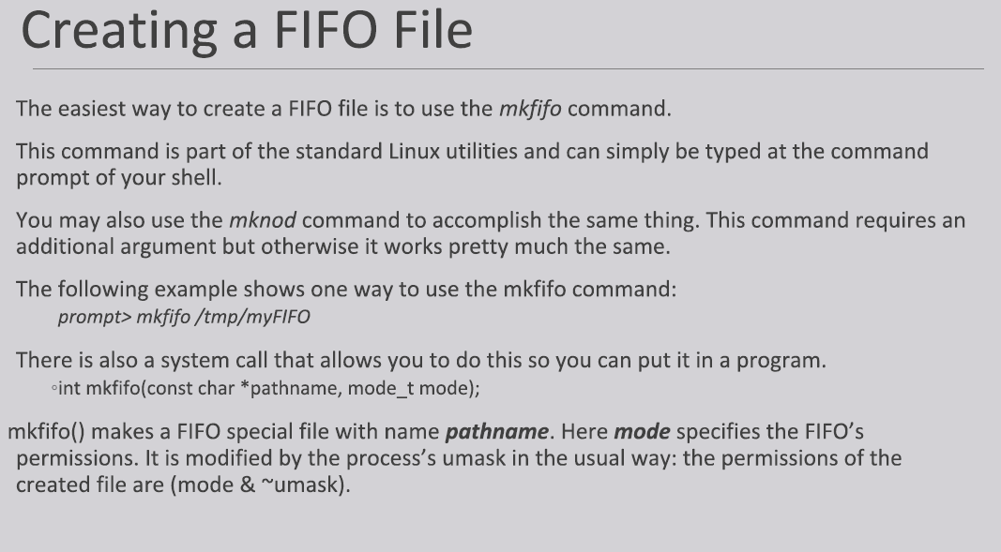

Slide 16
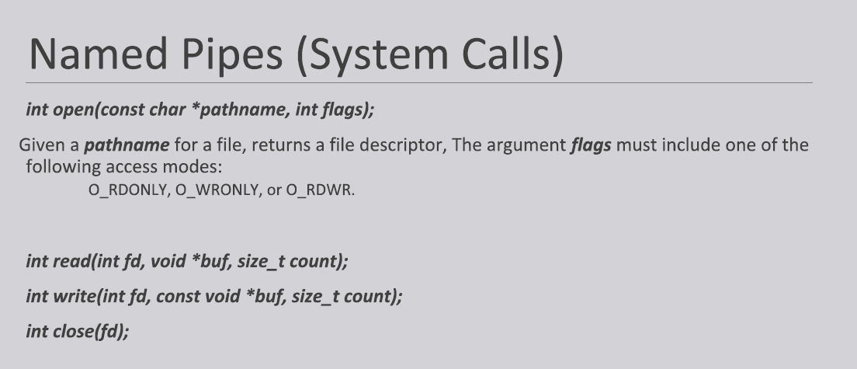

Slide 17
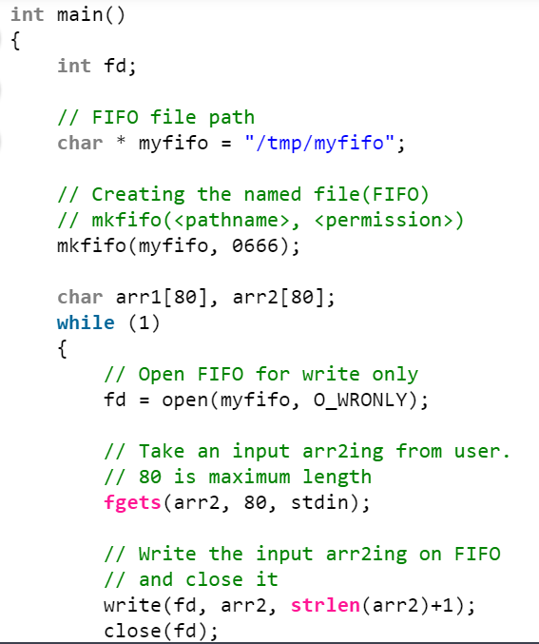
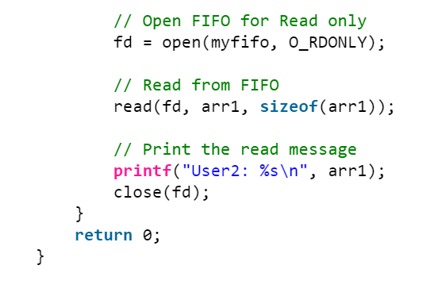
Process 1

Slide 18
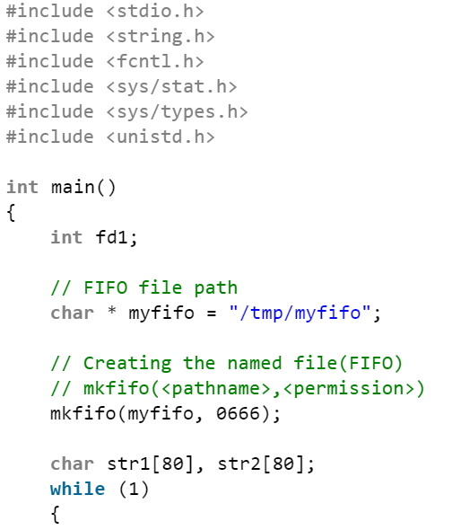
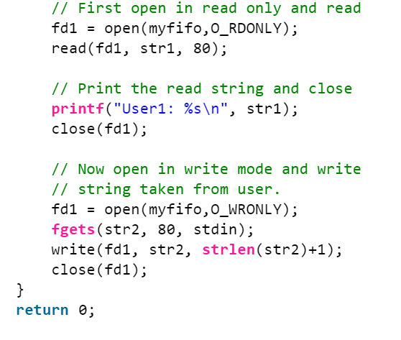
Process 2

Slide 19
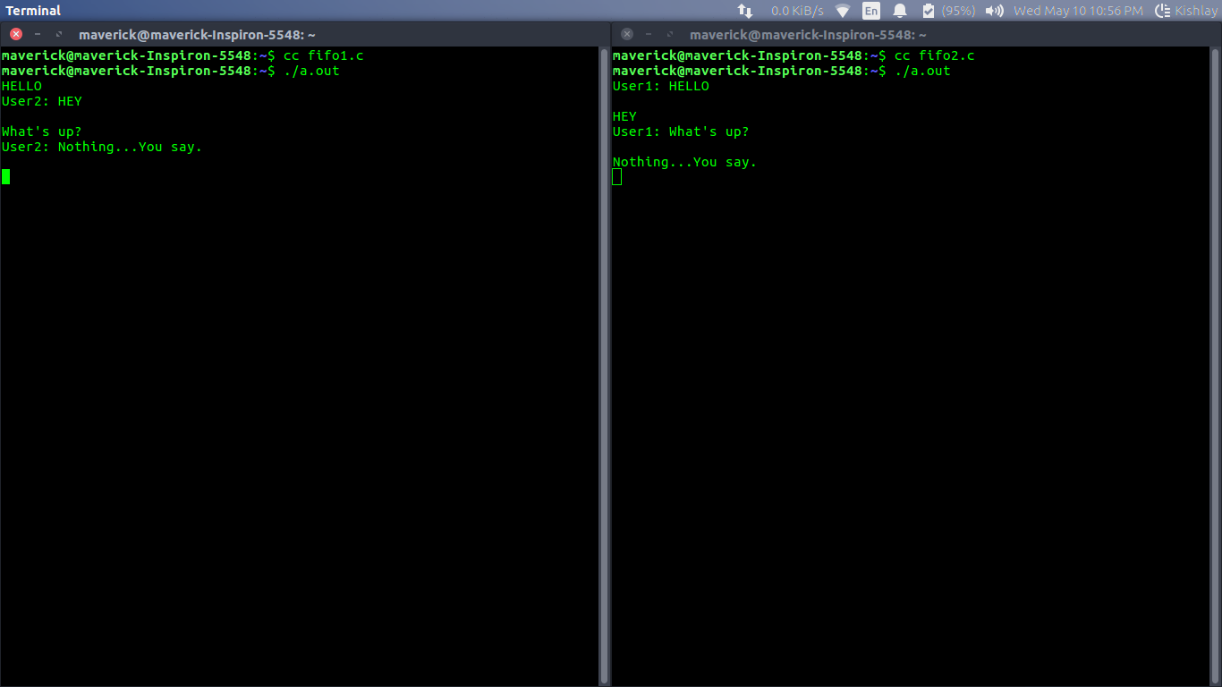
Output

Slide 20
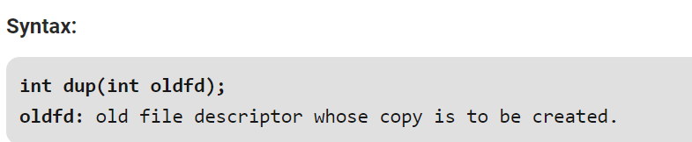
dup()
The dup() system call creates a copy of a file descriptor.
It uses the lowest-numbered unused descriptor for the new descriptor.
If the copy is successfully created, then the original and copy file descriptors may be used interchangeably.

Slide 21
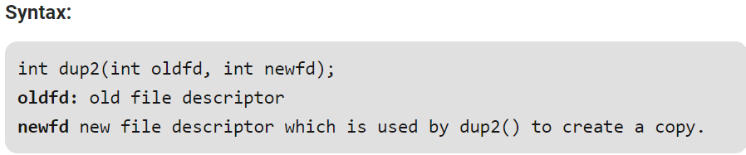
dup2()
The dup2() system call is similar to dup() but the basic difference between them is that instead of using the lowest-numbered unused file descriptor, it uses the descriptor number specified by the user.

